Slide 1



G. H. Raisoni College of Engineering & Management, Pune. Department of Computer Engineering
Vulnerable University
Guide : - Prof. Gayatri Bedre
Presented By : -
BCOA03 – Abhishek Birdawade
BCOB93 – Srushti Deshpande
BCOB111 – Vaibhav Wagh

Slide 2


Contents
Problem Statement
Literature Survey
Proposed System
Technology Used
Hardware & Software Required
Code
References

Slide 3

Problem Statement
Cyber security is a vast field and immerging daily. With increasing digital theft and cyber criminals, we need security tester and practitioner to help us tackle the increasing problem.
It is necessary for them to learn testing without violating cyber laws.
The vulnerable web application will provide a platform to learn and test their skills in their own local environment.

Slide 4
Literature Survey
Sr. No. | Paper Title | Author Name | Date | Findings
1. | Security Testing: A Survey | Michael Felderer, Matthias Büchler, Martin Johns | 03/11/2015 | This chapter provided a broad overview of recent security testing techniques.
2. | A security testing platform for Wireless Sensor Networks | Min Wei, Shuaidong Zhang, Keecheon Kim | 10/03/2016 | The test results show that the platform is a feasible platform for assessing device security levels in WSNs.
3. | Vulnerability Analysis Using the Interactive Application Security Testing (IAST) Approach for Government X Website Applications | Hermawan Setiawan, Lytio Enggar Erlangga, Ido Baskoro | 29/01/2021 | Using the IAST approach, a total of 249 vulnerability risks were identified.

Slide 5
Literature Survey
Sr. No. | Paper Title | Author Name | Date | Findings
4. | Intelligent Testing in Software Industry | Anushka Lal, Girish Kuma | 03/11/2021 | This study aims to investigate the approach of intelligent testing for improving software testability.
5. | Automated Cyber Security Testing Platform for Industrial Control System | Andrew Hahn, Daniel R. Sandoval, Raymond E. Fasano, Christopher Lamb | 23/10/2021 | A platform that incorporates these three components to provide the most accurate representation of actual NPP networks and controllers is developed in this paper.

Slide 6
Proposed System
Vulnerable University is damn vulnerable application which any user can easily download from our GitHub page for free and run on their local system with single command.
This application can also be used using Docker file for platform independency and without having need to download and install dependencies to run the application.
Our application consists of different technologies and their associated vulnerabilities for not only testing but also for learning and understanding different bugs.
Objectives
To identify the threats in the web application, servers & websites.
To find potential vulnerabilities of the system and try to resolve those vulnerabilities.
To help in detecting to every possible security risk in the system.
Examine the impact occurs due to vulnerabilities.
To help the organizations and developer teams to resolving the security problem.
Improve the skills of the security professionals.
Introducing the various kind of hacking techniques without violating cyber laws.
Provide cyber education to students regarding technical and non-technical vulnerabilities.

Slide 7
Proposed System
System Architecture Diagram
Command Injection
SQL Injection
Broken Authentication
Sensitive Data Exposure
Security misconfiguration
Browser
User
(Security Professional)
Request
Insecure deserialization
Broken Access Control
Response
Using component with known vulnerability
Cross-site scripting XSS
Client
Client Side
SSRF
XML entity
Vulnerable University - Application

Slide 8
Proposed System
III. Block Diagram
Researchers
Researchers download the application and run on their local system
Vulnerable University
Researchers will find vulnerabilities within the scope of application.
Vulnerability
Learn & Report Vulnerabilities.
Learning and Report

Slide 9
Technology Used
Django –
Django is free, open source and written in Python. We design application using Django because Django makes it easier to build application using Python. Django takes care of the difficult stuff so that we can concentrate on building our application. Django emphasizes reusability of components, also referred to as DRY (Don't Repeat Yourself), and comes with ready-to-use features like login system, database connection and CRUD operations (Create Read Update Delete).
Docker –
Docker is a set of platform as a service products that use OS-level virtualization to deliver software in packages called containers. The service has both free and premium tiers. The software that hosts the containers is called Docker Engine. By using this technology we make our application platform friendly. So, anyone can run this application on their own local system.

Slide 10


Technology Used
Node.js –
Node js is an open-source, cross-platform JavaScript runtime environment. It is used for generate dynamic page content. Node.js can collect form data and also add, delete, modify data in your database. Node.js files contain tasks that will be executed on certain events. A typical event is someone trying to access a port on the server. Node.js files have extension ".js".

Slide 11
Hardware & Software Required
Hardware Requirement
• 1 TB HDD
• 4/8 GB RAM
• i5 or above processor
2. Software Requirement
Operating System – Linux, Windows, Mac (platform independent)
Web Browser – Chrome, Firefox, etc
Docker
Node.js
GitHub account
Git command line tool
Python - Django

Slide 12
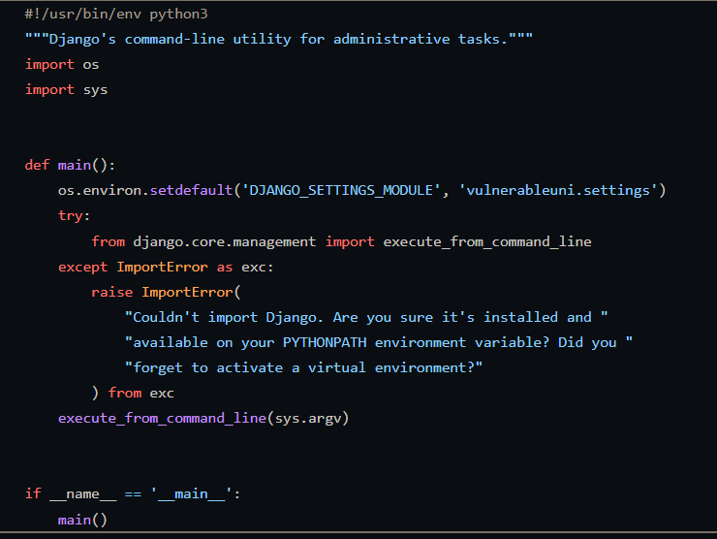
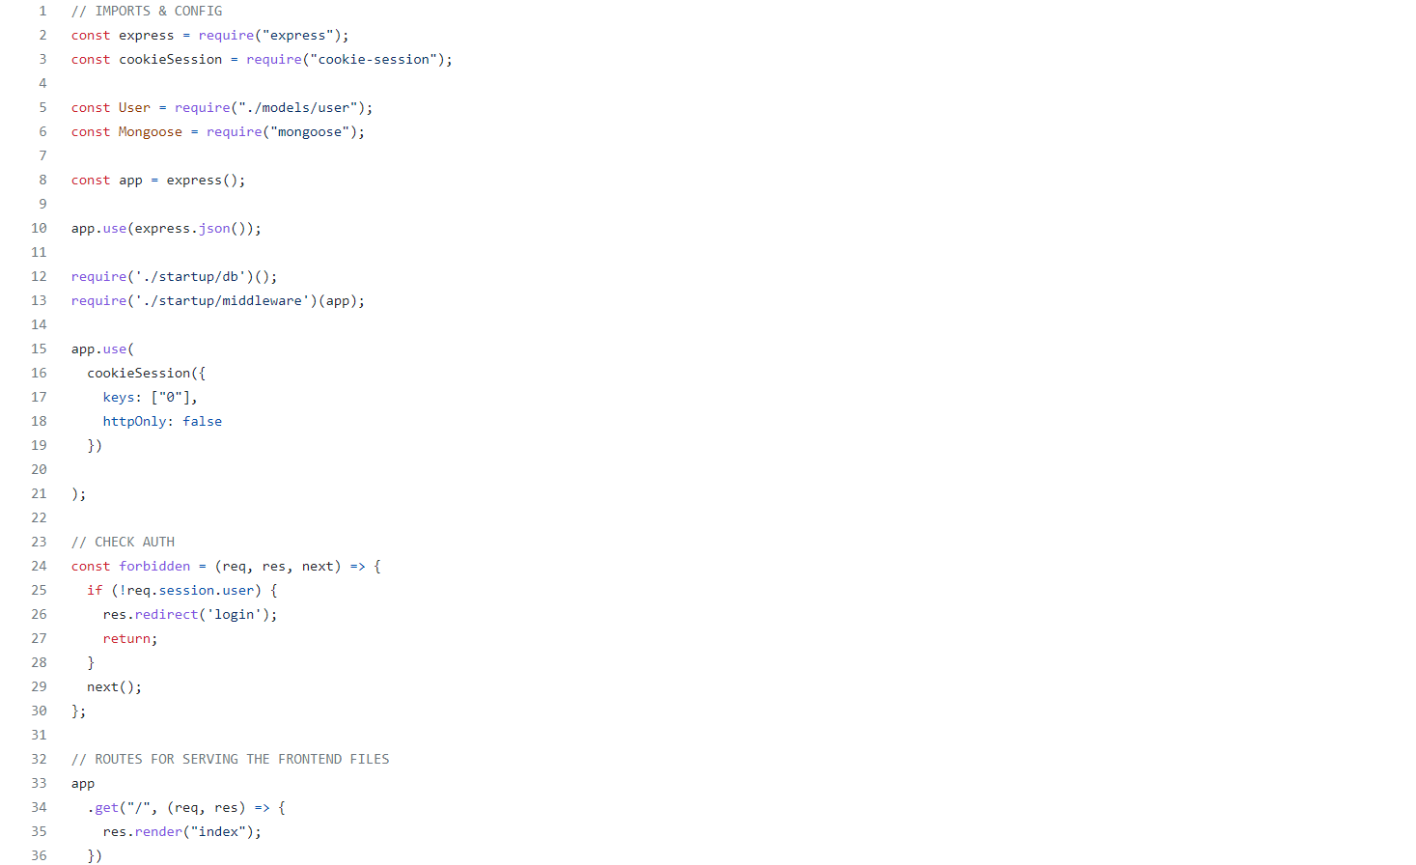
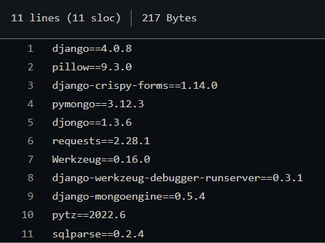
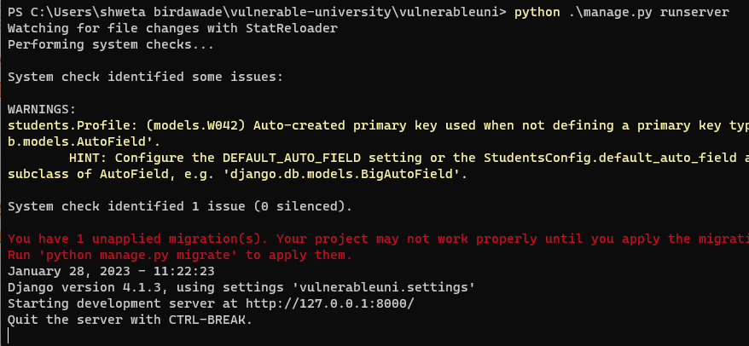
Code App-1

Slide 13
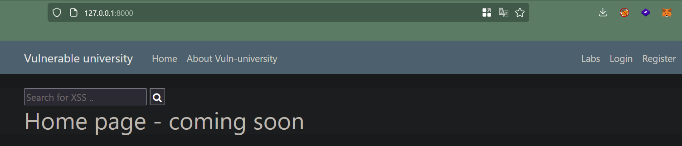
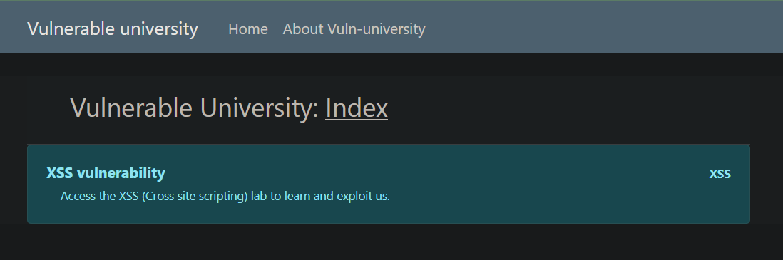
Output App-1

Slide 14
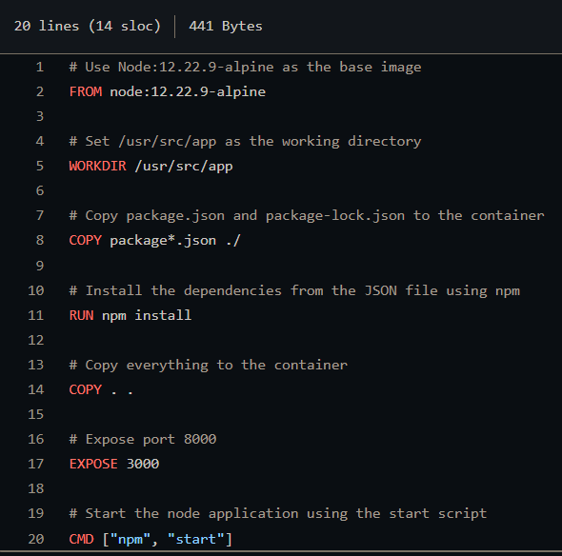
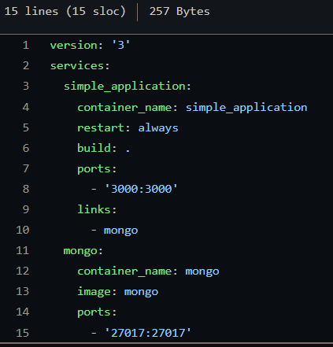
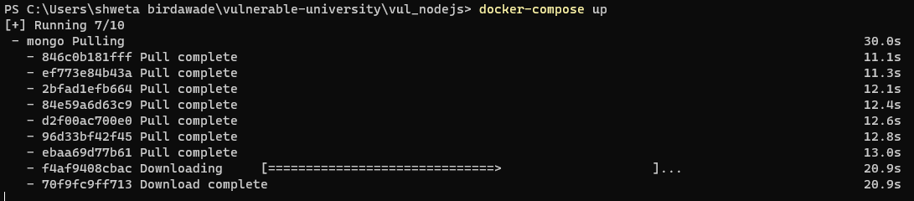
Code App-2

Slide 15
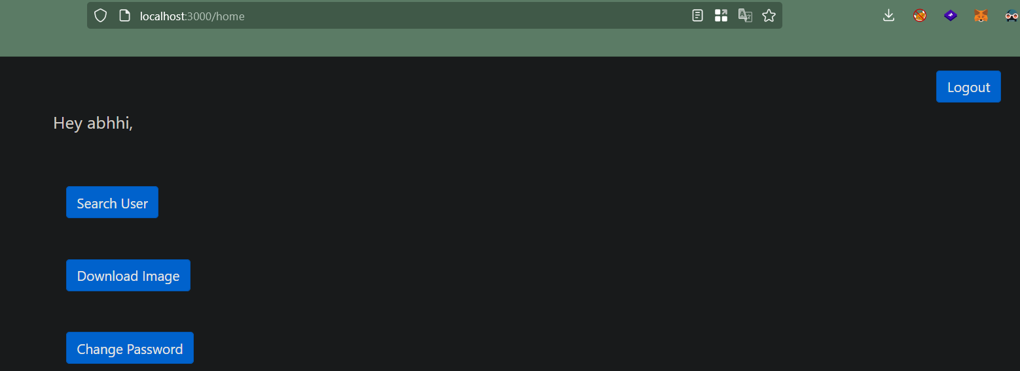
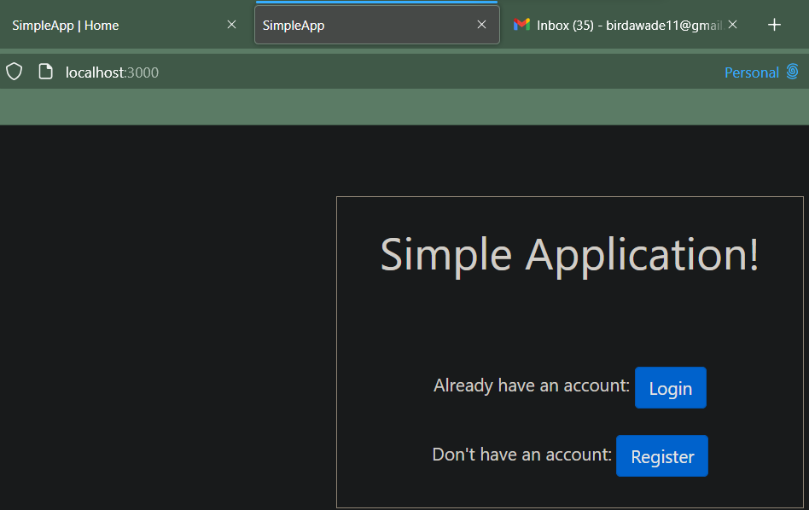
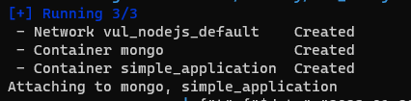
Output App-2

Slide 16
References
https://www.researchgate.net/publication/297918097_Security_Testing_A_Survey
https://ieeexplore.ieee.org/document/7427093/metrics#metrics
https://www.cigniti.com/resource/white-papers/security-testing-tools-experiences-recommendations/
https://www.osti.gov/servlets/purl/1854691
https://securitytrails.com/blog/vulnerable-websites-for-penetration-testing
https://tryhackme.com/network/throwback
https://tryhackme.com
https://hackthebox.com
https://github.com/abhhi-101/vulnerable-university

Slide 17
References
Thank You

